Slide 1
Entrepreneurship Motivation

Slide 2
Motivation
Motivation is the reason for people's actions, willingness and goals. Motivation is derived from the word motive which is defined as a need that requires satisfaction.
Key Elements:-
Intensity- how hard a person tries.
Direction- towards beneficial or goal.
Persistence-how long a person tries.

Slide 3
TYPES OF MOTIVATION
1. Intrinsic Motivation- Intrinsic motivation is a type of motivation in which an individual is being motivated by internal desires.
2. Extrinsic Motivation- Extrinsic motivation, on the other hand, is a type of motivation in which an individual is being motivated by external desires.

Slide 4
Entrepreneurial motivation
The entrepreneurial motivation is the process that activates and motivates the entrepreneur to exert higher level of efforts for the achievement of his/her entrepreneurial goals.

Slide 5
General Entrepreneurial motivation factors
Need for achievement,
Locus of control
Vision
Desire for independence
Passion
Drive(a very strong need or desire in human beings)

Slide 6
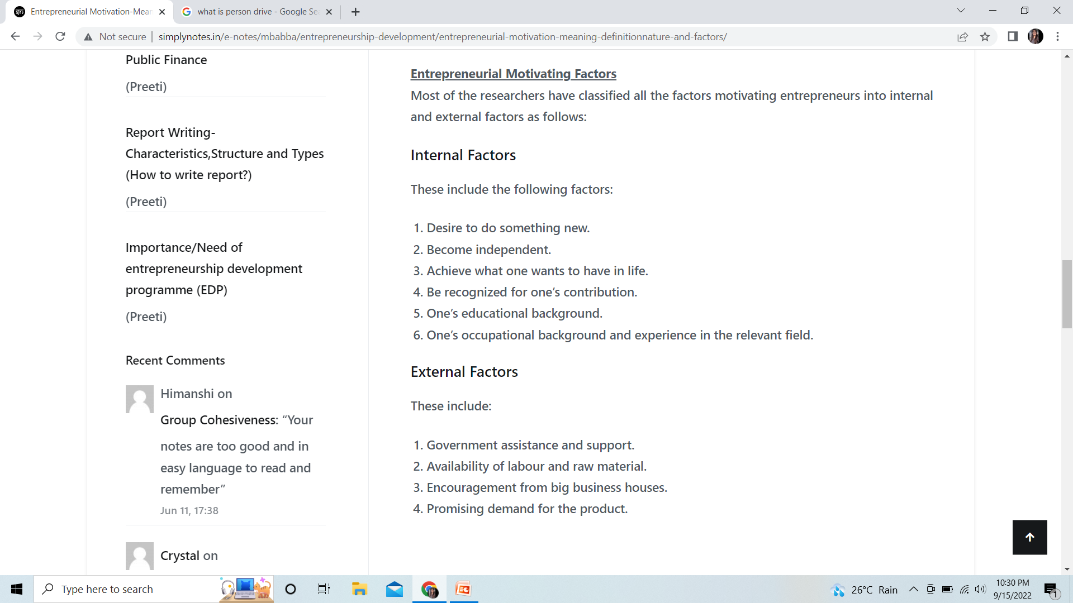

Slide 7
David McClelland’s theory of Achievement motivation
Motivation is an important determinant for entrepreneurial growth.
Three motives for accomplishing things:
Need for Power (nP), or the drive to influence others and any given situation.
Need for Affiliation (nAff), or the drive for interpersonal relationship.
Need for Achievement (nAch), or the drive to excel, advance, and grow.
*ALREADY COVERED IN Psychological MODEL*

